Slide 1
Researching Project IoT Platform using Laravel and Mobile App
‘ Week8 Report ’
Lecturer: Mr. HEL Chanthan
Prepared by Mr. VANNAK Sovannroth
2019-2020

Slide 2
Outline
Planning for First Month
Planning for Second Month
Main Coding and Emulator
Adding Library of Charts in Flutter
Coding
Sample Charts Code
View on Mobile Application
PAGE 01

Slide 3
Planning for First Month
Activity (Start on 06.08.2020) | Thursday (Presentation day) | Friday | Monday | Tuesday | Wednesday (Meeting day)
Week 1 | Installation MongoDB (Shell and Compass) and connect localhost between Shell and Compass.(Locally) | Performing CRUD (Create, Read, Update, Delete) on Mongo Shell and MongoDB Compass. | Creating MongoDB Atlas account and connect it to Mongo Shell or MongoDB Compass, and Driver (Node.js).(Cloud) | Installation Visual Studio Code and connect driver to MongoDB Atlas.(Cloud) | Connecting sample Backend to MongoDB Cluster and storing Products in the Database.
Week 2 | Connecting driver to Mongo Shell.(Locally) | Starting to build sample backend connect with or without MongoDB Atlas. | Build creating, editing and deleting Products on server. | Transmitting and fetching data to/from the Database. | Creating Login and Signup. (Email and password)
Week 3 | Learning template Bootstrap 4 | Install wampserver and Laravel | Run Laravel server with MySQL(Database) | Choose free template Bootstrap for Front-End & Backend | Installation Laravel Module for Backend and Front-End
Week 4 | Starting to build backend for project. & Creating Login and Signup. | User management: • Create new user • Reset user password • Delete and edit user | Manage Info: • Logo • Name • Contact info • Map • Social | Manage new category: • Create new category • Edit and delete exiting categories. | Manage news: • Post news • Edit news • Delete news
PAGE 02

Slide 4
Planning for Second Month
Activity (Start on 06.08.2020) | Thursday (Presentation day) | Friday | Monday | Tuesday | Wednesday (Meeting day)
Week 5 | Create Dashboard | Create Dashboard | Manage Calculate: • Addition • Subtraction • Multiplication • Division | Write API & Read API | Write API & Read API
Week 6 | Connect to ESP8266 or NodeMcu & fetch data from Arduino | Get data from Sensors and Calculate. | Show data on Dashboard | Connect Backend to Front-End | Front-End fetch data from Backend
Week 7 | Choose Flutter or React Native for build Mobile App. | Learning Flutter or React native | Start build sample project | Create Horizontal list view & build recent products grid view. | Manage Info: • Product details • Home page Ui modification • Shopping cart & list page • User login & Register • Contact info
Week 8 | Creating Users, brand and category on database & Adding products to the database. | Auto complete search for categories and brands & Uploading Images to firebase. | Login and signup screen redesign & Google sign in for IOS and Android . | Firebase Auth using provider package & Dashboard UI/UX and Database product modeling. | Load products from firebase part & loading products from database.
PAGE 03

Slide 5
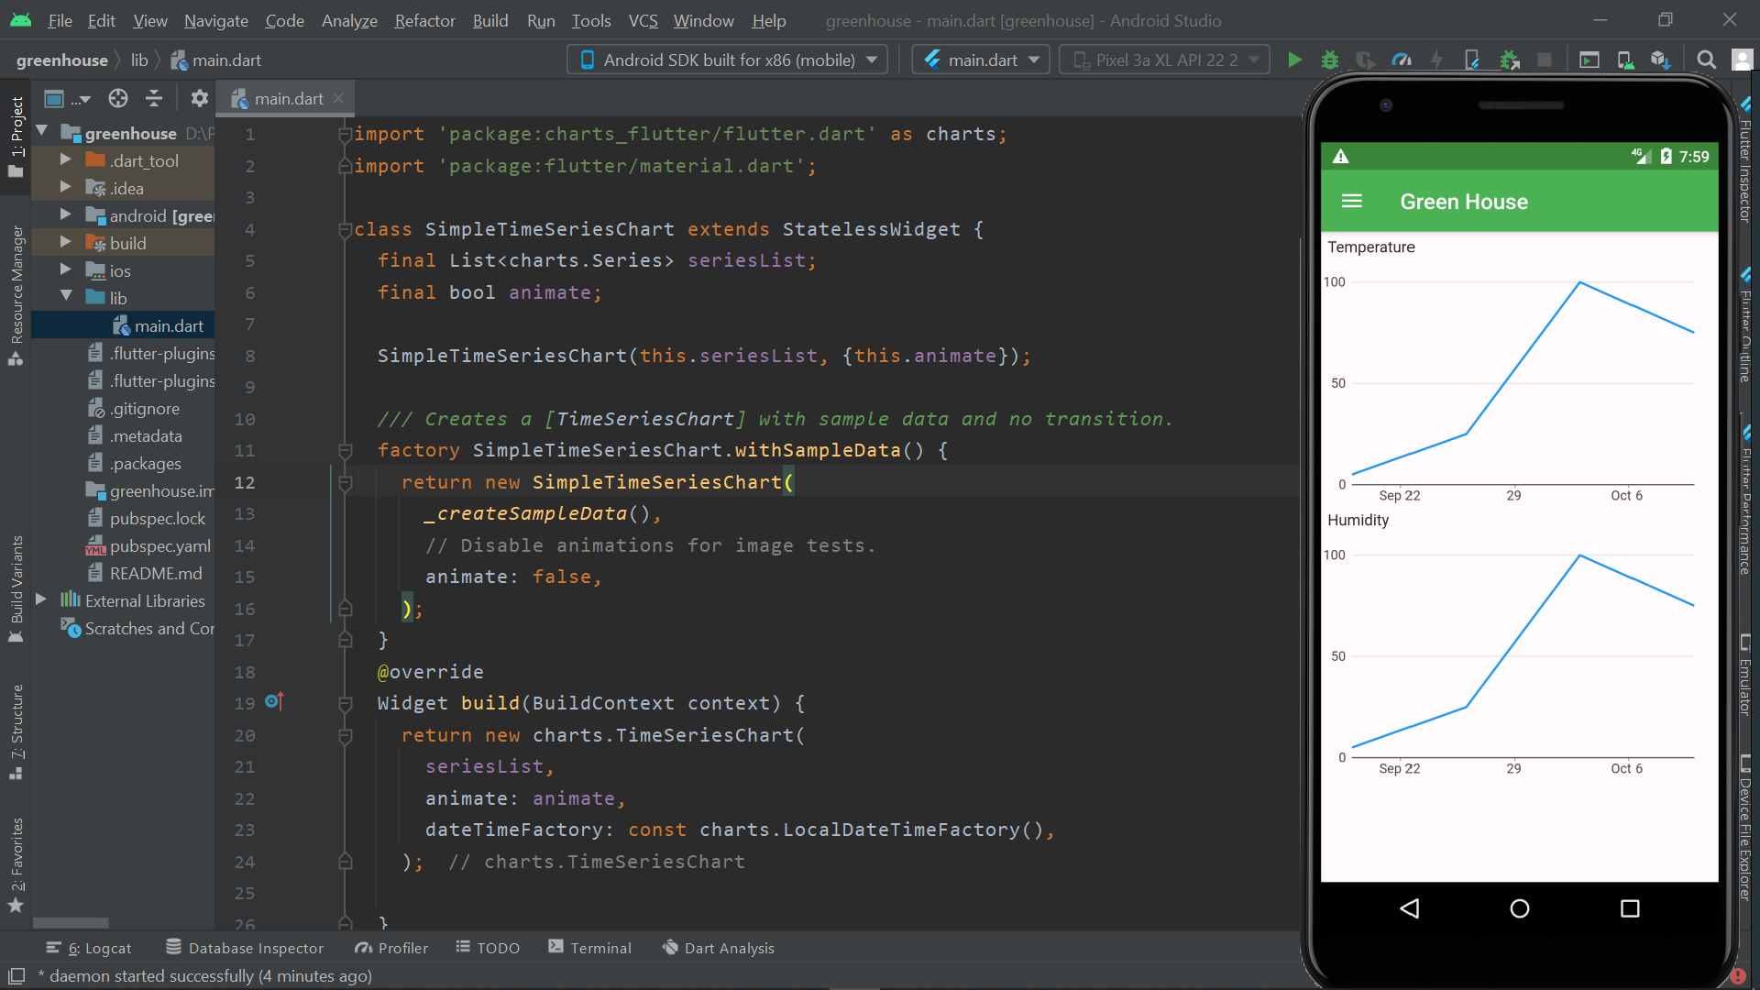
<<< Main Coding and Emulator >>>>
PAGE 04

Slide 6
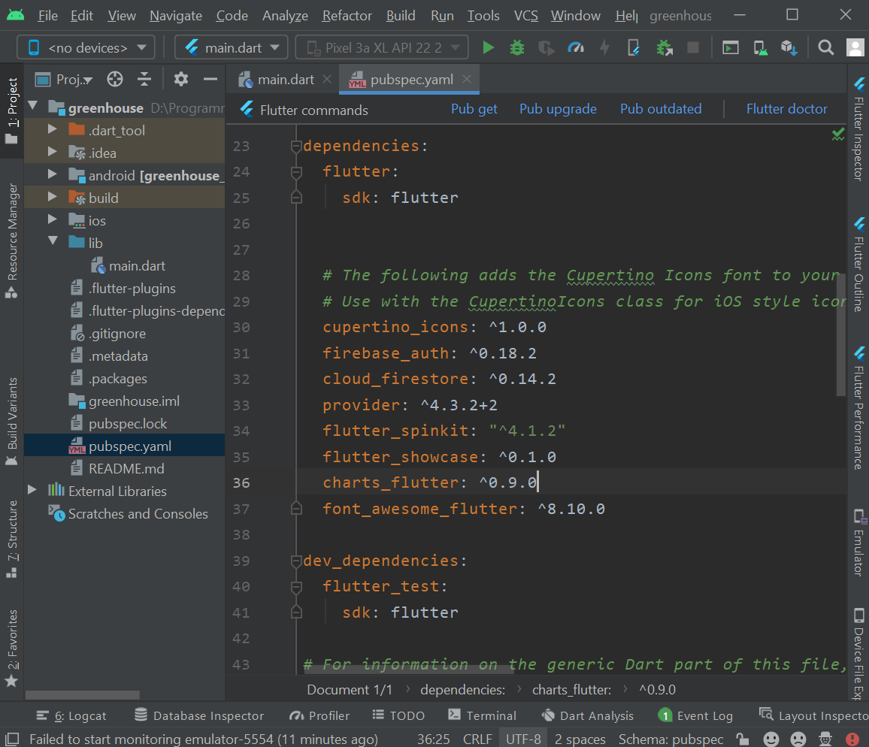
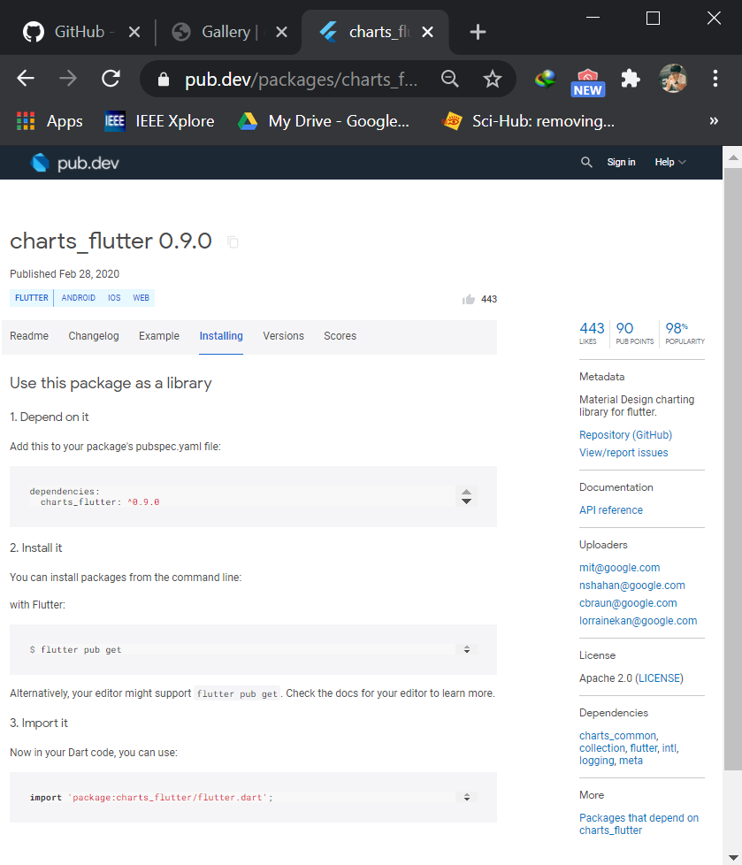
<<< Adding Library of Charts in Flutter>>>>
https://pub.dev/packages/charts_flutter/install
PAGE 05

Slide 7
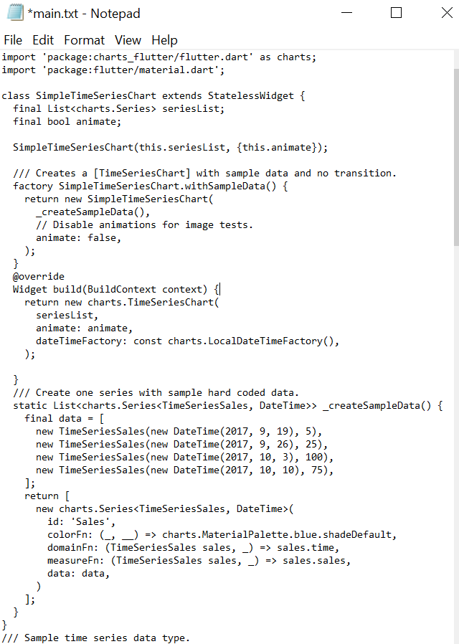
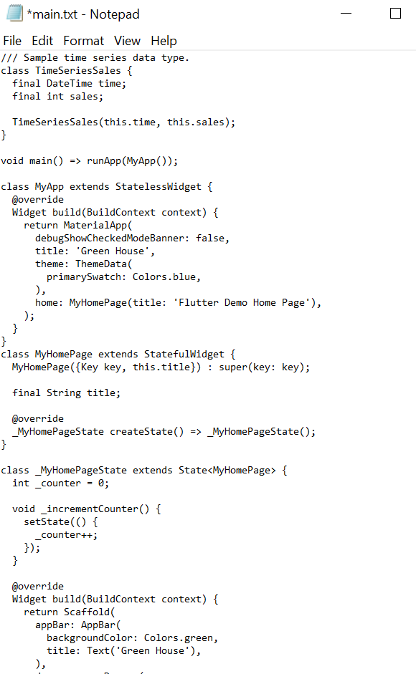
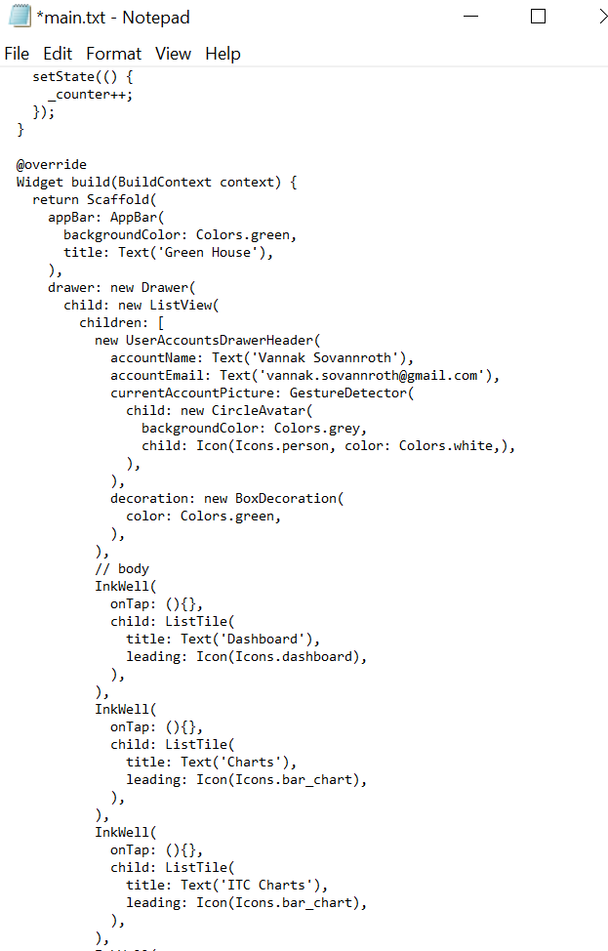
<<< Coding>>>>
PAGE 06

Slide 8
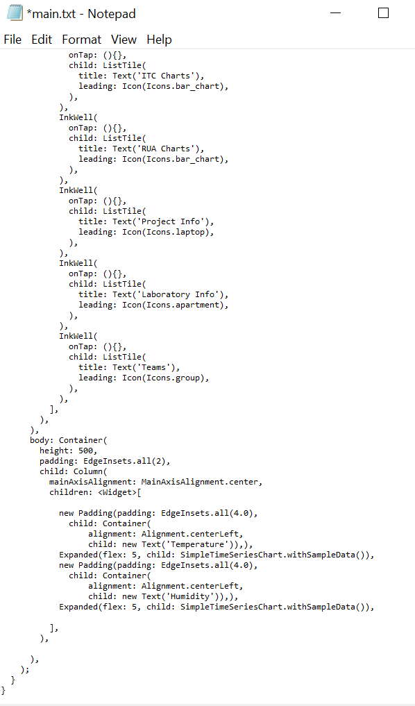
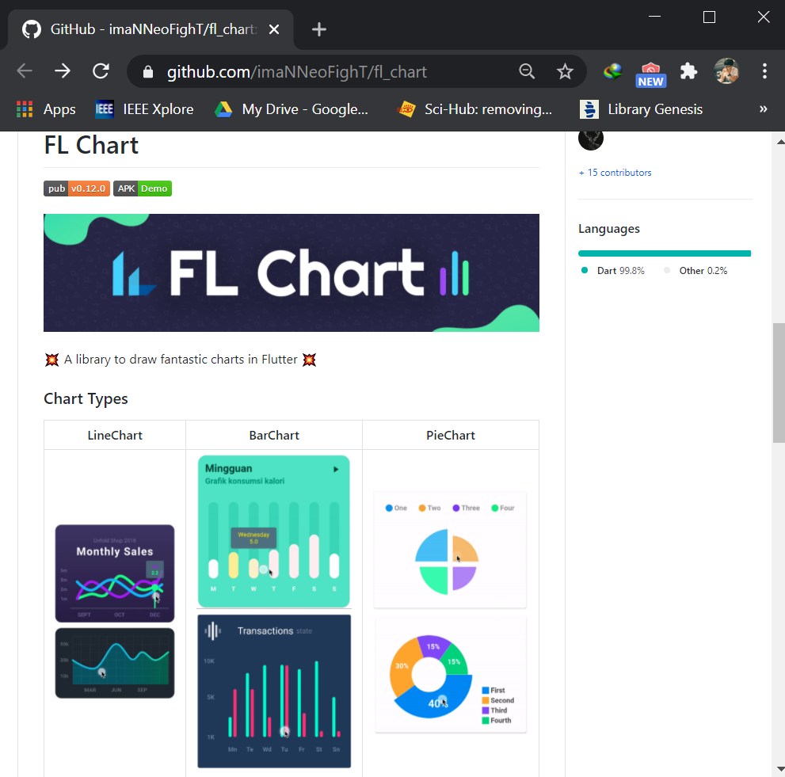
<<< Coding>>>>
https://github.com/imaNNeoFighT/fl_chart
PAGE 07

Slide 9
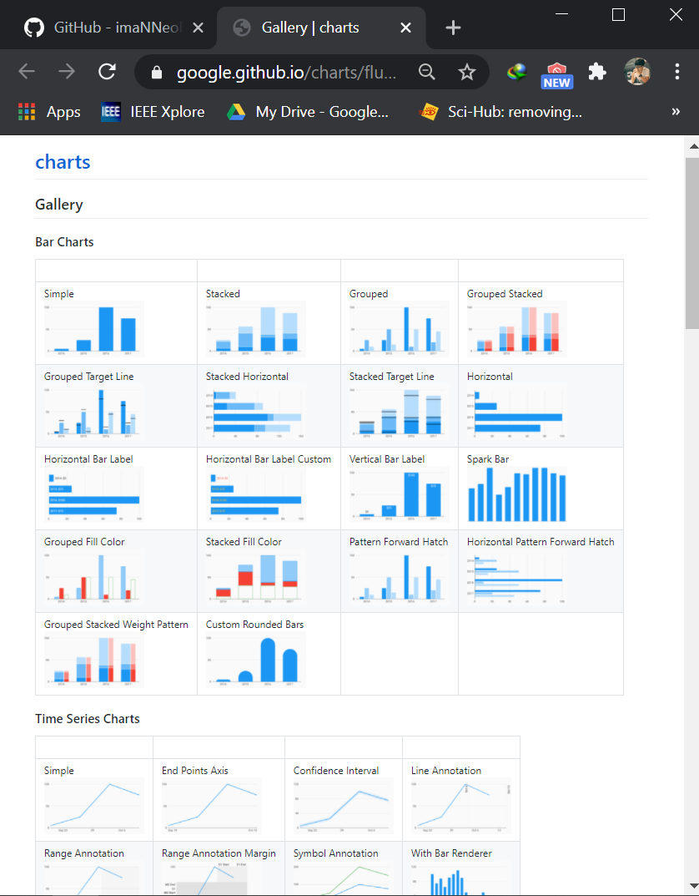
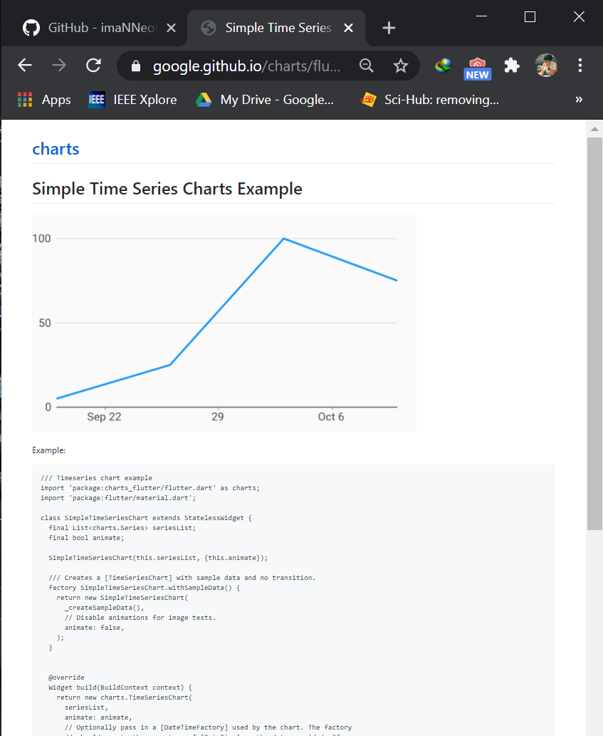
<<< Sample Charts Code >>>>
https://google.github.io/charts/flutter/gallery.html
PAGE 08

Slide 10
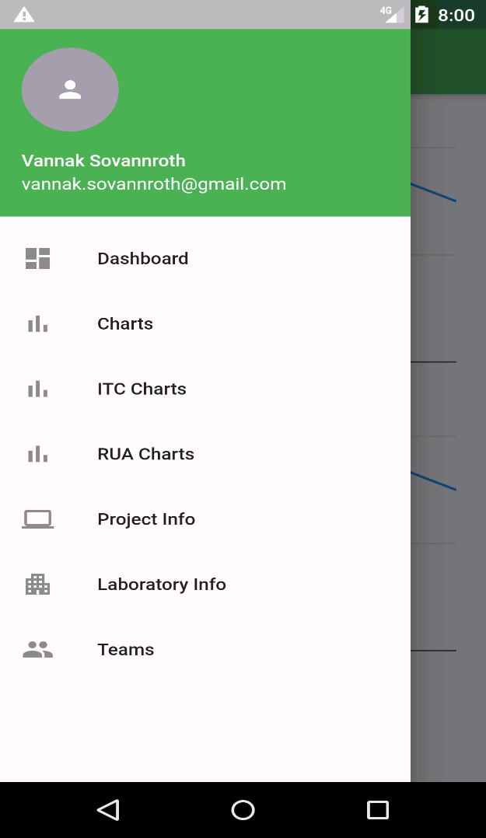
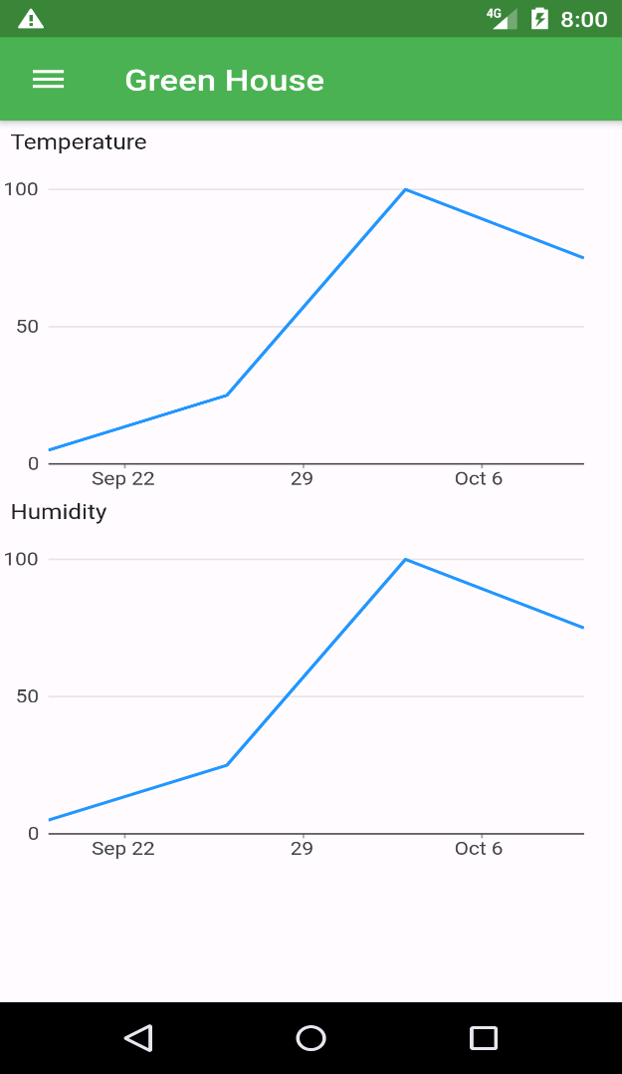
<<< View on Mobile Application >>>>
PAGE 09

Slide 11
Thank You!

